Slide 1
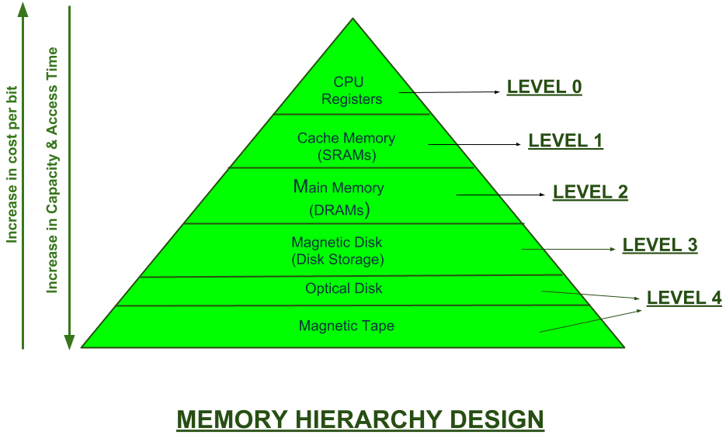
Memory Hierarchy Design and its Characteristics
In the Computer System Design, Memory Hierarchy is an enhancement to organize the memory such that it can minimize the access time. The Memory Hierarchy was developed based on a program behavior known as locality of references. The side figure clearly demonstrates the different levels of memory hierarchy.
This Memory Hierarchy Design is divided into 2 main types:
External Memory or Secondary Memory – Comprising of Magnetic Disk, Optical Disk, Magnetic Tape i.e. peripheral storage devices which are accessible by the processor via I/O Module.
Internal Memory or Primary Memory – Comprising of Main Memory, Cache Memory & CPU registers. This is directly accessible by the processor.
We can infer the following characteristics of Memory Hierarchy Design from side figure:
Capacity: It is the global volume of information the memory can store. As we move from top to bottom in the Hierarchy, the capacity increases.
Access Time: It is the time interval between the read/write request and the availability of the data. As we move from top to bottom in the Hierarchy, the access time increases.
Performance: Earlier when the computer system was designed without Memory Hierarchy design, the speed gap increases between the CPU registers and Main Memory due to large difference in access time. This results in lower performance of the system and thus, enhancement was required. This enhancement was made in the form of Memory Hierarchy Design because of which the performance of the system increases. One of the most significant ways to increase system performance is minimizing how far down the memory hierarchy one has to go to manipulate data.
Cost per bit: As we move from bottom to top in the Hierarchy, the cost per bit increases i.e. Internal Memory is costlier than External Memory.

Slide 2
What is Virtual Memory?
Virtual memory in computer organization architecture is a technique and not actually a memory in physical form present in computer system. This is the reason it is known as virtual memory.
Virtual memory in COA is simply a technique used to provide an illusion of presence of large main memory to the programmer, when in actual it’s not present physically.
The size of virtual memory is equivalent to the size of secondary memory. Each virtual address or logical address referenced by the CPU is mapped to a physical address in main memory.
A hardware device called Memory Management Unit (MMU) performs this mapping during run time. To perform this activity MMU actually takes help of a memory map table, which is maintained by the operating system.
Virtual memory is a method that computers use to manage storage space to keep systems running quickly and efficiently. Using the technique, operating systems can transfer data between different types of storage, such as random access memory (RAM), also known as main memory, and hard drive or solid-state disk storage. At any particular time, the computer only needs enough active memory to support active processes. The system can move those that are dormant into virtual memory until needed.
What is logical address space and physical address space?
The set of all logical address generated by CPU or program is known as logical address space. It is also called as virtual address space.
The set of all physical addresses corresponding to the above logical addresses is known as physical address space.
The complete procedure is something like this. When a program is required to be executed then the CPU or program would generate a addresses called logical addresses. And executing program occupies corresponding addresses in physical memory called as physical address.

Slide 3
A virtual memory system has many advantages, including:
Allowing users to operate multiple applications at the same time or applications that are larger than the main memory
Freeing applications from having to compete for shared memory space and allowing multiple applications to run at the same time
Allowing core processes to share memory between libraries, which consists of written code that provides the foundation for a program's operations
Improving security by isolating and segmenting where the computer stores information
Improving efficiency and speed by allowing more processes to sit in virtual memory
Lowering the cost of computer systems as you find the right amount of main memory and virtual memory
Increasing the amount of memory available by working outside the limits of a computer's physical main memory space
Optimizing central processing unit (CPU) usage.
Types of Virtual Memory
The two ways computers handle virtual memory are through paging and segmenting.

Slide 4
1. Paging
Paging is a virtual memory technique that separates memory into sections called paging files. When a computer reaches its RAM limits, it transfers any currently unused pages into the part of its hard drive used for virtual memory. The computer performs this process using a swap file, a designated space within its hard drive for extending the virtual memory of the computer's RAM. By moving unused files into its hard drive, the computer frees its RAM space for other memory tasks and ensures that it doesn't run out of real memory.
As part of this process, the computer uses page tables, which translate virtual addresses into the physical addresses that the computer's memory management unit (MMU) uses to process instructions. The MMU communicates between the computer's OS and its page tables. When the user performs a task, the OS searches its RAM for the processes to conduct the task. If it can't find the processes to complete the task in RAM, the MMU prompts the OS to move the required pages into RAM and uses a page table to note the new storage location of the pages.
2. Segmenting
Segmentation is another method of managing virtual memory. A segmentation system divides virtual memory into varying lengths and moves any segments that aren't in use from the computer's virtual memory space to its hard drive. Like page tables, segment tables track whether the computer stores the segment in memory or a physical address. Segmentation differs from paging because it divides memory into sections of varying lengths, while paging divides memory into units of equal size. With paging, the hardware determines the size of a section, but the user can select the length of a segment in a segmentation system.
Segmentation is often slower than paging, but it offers the user more control over how to divide memory and may make it easier to share data between processes. You can customize the segments based on the machine's purpose and usage. Casual computer users may prefer a paging system because it automatically handles memory divisions.

Slide 5
S.NO | Paging | Segmentation
1. | In paging, the program is divided into fixed or mounted size pages. | In segmentation, the program is divided into variable size sections.
2. | For the paging operating system is accountable. | For segmentation compiler is accountable.
3. | Page size is determined by hardware. | Here, the section size is given by the user.
4. | It is faster in comparison to segmentation. | Segmentation is slow.
5. | Paging could result in internal fragmentation. | Segmentation could result in external fragmentation.
6. | In paging, the logical address is split into a page number and page offset. | Here, the logical address is split into section number and section offset.
7. | Paging comprises a page table that encloses the base address of every page. | While segmentation also comprises the segment table which encloses segment number and segment offset.
8. | The page table is employed to keep up the page data. | Section Table maintains the section data.
9. | In paging, the operating system must maintain a free frame list. | In segmentation, the operating system maintains a list of holes in the main memory.
10. | Paging is invisible to the user. | Segmentation is visible to the user.
11. | In paging, the processor needs the page number, and offset to calculate the absolute address. | In segmentation, the processor uses segment number, and offset to calculate the full address.
12. | It is hard to allow sharing of procedures between processes. | Facilitates sharing of procedures between the processes.
13 | In paging, a programmer cannot efficiently handle data structure. | It can efficiently handle data structures.
14. | This protection is hard to apply. | Easy to apply for protection in segmentation.
15. | The size of the page needs always be equal to the size of frames. | There is no constraint on the size of segments.
16. | A page is referred to as a physical unit of information. | A segment is referred to as a logical unit of information.
17. | Paging results in a less efficient system. | Segmentation results in a more efficient system.

Slide 6
Limitations of virtual memory
Virtual memory has many advantages, but it also has some limitations. Here are a few to keep in mind:
Virtual memory runs slower than physical memory, so most computers prioritize using physical memory when possible.
Moving data between a computer's virtual and physical memory requires more from the computer's hardware.
The amount of storage that virtual memory can provide depends on the amount of secondary storage a computer has.
If a computer only has a small amount of RAM, virtual memory can cause thrashing, which is when the computer must constantly swap data between virtual and physical memory, resulting in significant performance delays.
It can take longer for applications to load or for a computer to switch between applications when using virtual memory.

